Slide 1
Hyperparameters
Lecture III
Alexei Prokudin
PHYS496

Slide 2
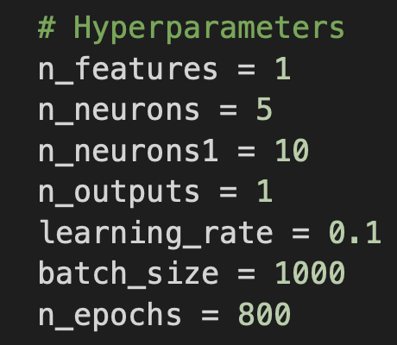
HYPERPARAMETERS
Hyperparameters are parameters in machine learning models that are set before training and cannot be learned directly from the data during the training process. Unlike model parameters (like weights and biases), which are learned, hyperparameters control the behavior of the learning algorithm and influence how the model is trained.
Tuning Hyperparameters:
Because hyperparameters are not learned automatically, they need to be tuned through experimentation or optimization techniques such as:
Grid Search: Trying all combinations of hyperparameter values.
Random Search: Randomly selecting combinations of hyperparameter values.
Bayesian Optimization: A more advanced technique that models the performance of different hyperparameter values to find the best ones more efficiently.
Hyperparameters have a critical impact on both the training process and the performance of the model. Finding the right combination is often key to building a well-performing model.

Slide 3
HYPERPARAMETERS
Key Types of Hyperparameters:
Learning Rate:
Controls how much to adjust the weights of the network with respect to the loss gradient.
A small learning rate can result in slow convergence, while a large one can lead to overshooting and unstable training.
Batch Size:
Refers to the number of training examples used to calculate the gradient in a single update during training.
Smaller batches lead to more updates (and noise) in learning but might generalize better. Larger batches stabilize learning but may converge to suboptimal solutions.
Number of Epochs:
Defines how many times the entire training dataset is passed through the neural network during training.
Too few epochs may result in underfitting, while too many can lead to overfitting.

Slide 4
HYPERPARAMETERS
Key Types of Hyperparameters:
Number of Layers and Neurons (Network Architecture):
Specifies the depth (number of layers) and width (number of neurons per layer) of the network.
A deeper and wider network can model more complex functions but may require more data and computational resources.
Activation Functions:
These are used to introduce non-linearity into the network and include functions like ReLU, sigmoid, or tanh.
Choosing an appropriate activation function can significantly affect learning performance and convergence.
Dropout Rate:
Dropout is a regularization technique that randomly disables a fraction of neurons during training to prevent overfitting.
The dropout rate is the probability that a neuron is "dropped" during an update. Common values are between 0.2 and 0.5.

